Slide 1
Proof Techniques
Proof is a kind of demonstration to convince that the given mathematical statement is true.
The statement which is to be proved is called theorem. Once a particular theorem is proved then it can be used to prove further statements.
The theorem is also called as Lemma.
The proof can be a deductive proof or inductive proof.
The deductive proof consist of sequence of statements given with logical reasoning.
The inductive proof is a recursive kind of proof which consists of sequence or parameterized statements that use the statement itself or the statement with lower values of its parameter.
Various methods of proofs are-
Proof by contradiction
Proof by mathematical induction
Direct proofs
Proof by counter example
Proof by contraposition

Slide 2
Proof by Contradiction
In this type of proof, for the statement of the form if A then B.
We start with statement A is not true and thus by assuming false A, we try to get the conclusion of statement B.
When it becomes impossible to reach to statement B, we contradict our self and accept that A is true.
For example,
Prove P ∪ Q = Q ∪ P

Slide 3
Prove P ∪ Q = Q ∪ P
Proof
Initially we assume that P ∪ Q = Q ∪ P is not true. i.e. P ∪ Q ≠ Q ∪ P
Now consider that x is in Q, or x is in P. hence we can say x is in P ∪ Q ( according to definition of union)
But this also implies that x is in Q ∪ P according to definition of union.
Hence the assumption which we made initially is false.
Thus P ∪ Q = Q ∪ P is proved.

Slide 4
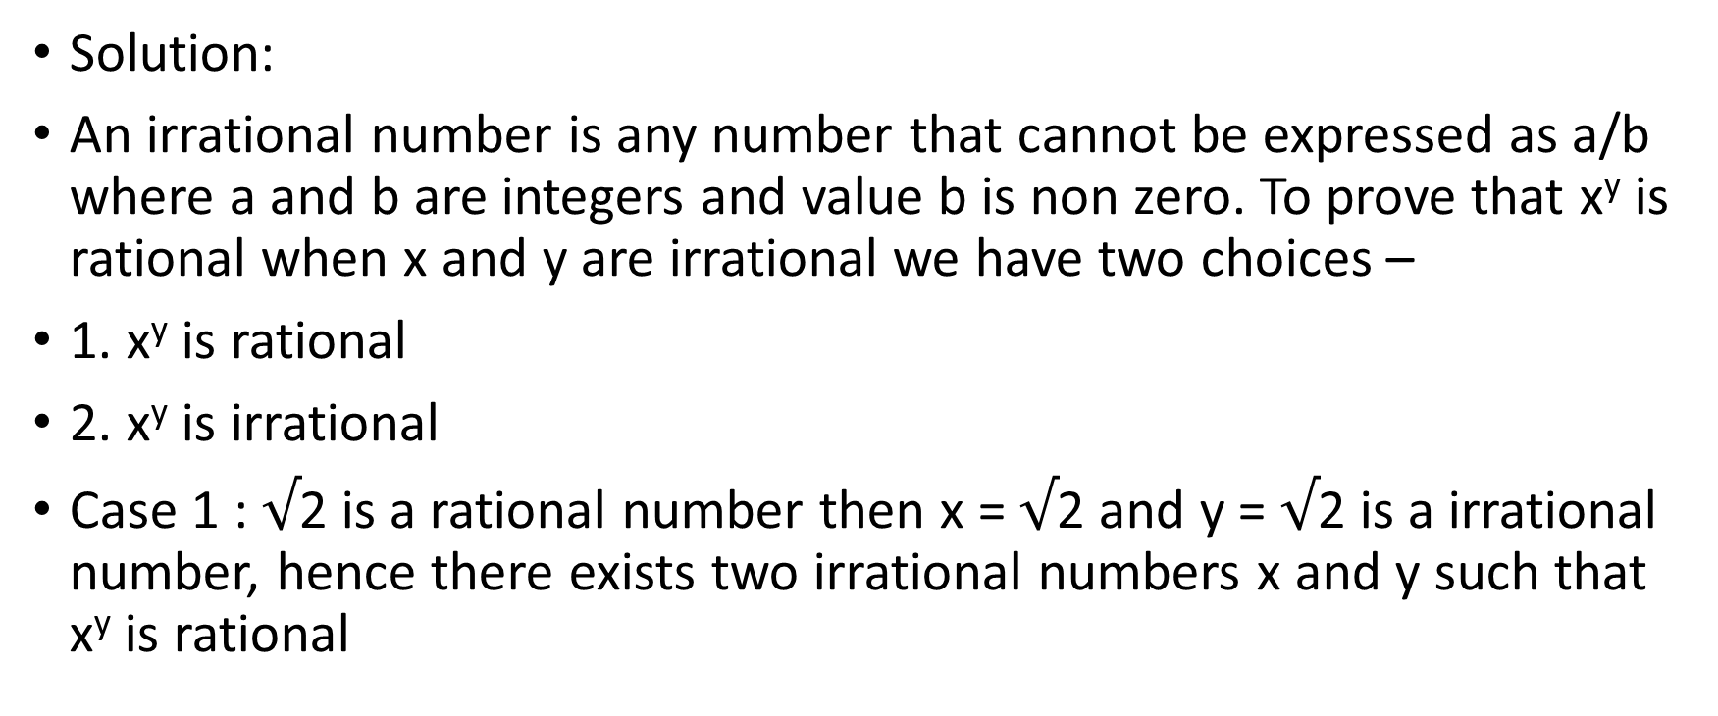
Prove by contradiction. There exist two irrational numbers x and y such that x^{y} is rational.
Solution:
An irrational number is any number that cannot be expressed as a/b where a and b are integers and value b is non zero. To prove that x^{y} is rational when x and y are irrational we have two choices –
1. x^{y} is rational
2. x^{y} is irrational
Case 1 : $√$2 is a rational number then x = $√$2 and y = $√$2 is a irrational number, hence there exists two irrational numbers x and y such that x^{y} is rational

Slide 5
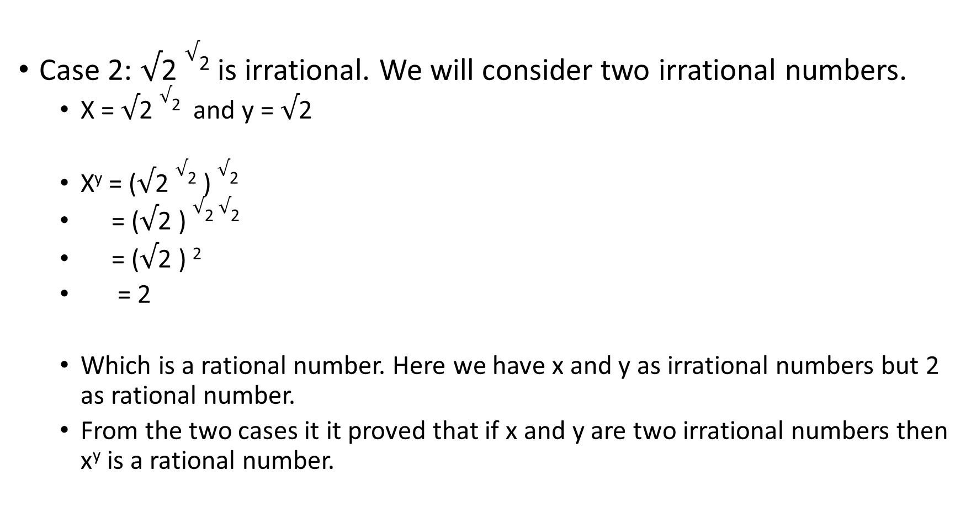
Case 2: $√$2 $√$² is irrational. We will consider two irrational numbers.
X = $√$2 $√$² and y = $√$2
X^{y} = ($√$2 $√$² ) $√$²
= ($√$2 ) $√$² $√$²
= ($√$2 ) ²
= 2
Which is a rational number. Here we have x and y as irrational numbers but 2 as rational number.
From the two cases it it proved that if x and y are two irrational numbers then x^{y} is a rational number.

Slide 6
Proof by Mathematical Induction
Inductive proofs are special proofs based on some observations.
It is used to prove recursively defined objects. This type of proof is also called as proof by mathematical induction.
The proof by mathematical induction can be carried out using following steps:
Basic: in this step, we assume the lowest possible value. This is an initial step in the proof by mathematical induction.
For example, we can prove that the result is true for n = 0 or n = 1
Induction Hypothesis: in this step, we assign value of n to some other value k. that mean, we will check whether the result is true for n – k or not.
Inductive Step: in this step, if n = k is true then we check whether the result is true for n = k + 1 or not.
If we get the same result at n = k + 1 then we can state that given proof is true by principle of mathematical induction

Slide 7
Example : 1 Prove: 1 + 2 + 3 …. + n = n ( n + 1 ) / 2
Solution: initially,
1) Basis of induction –
Assume, n = 1 then
L. H. S. = n = 1
R. H. S. = n ( n + 1 ) / 2 = 1 ( 1 + 1) / 2 = 2 / 2 = 1
2) Induction hypothesis –
Now we will assume n = K and will obtain the result for it. The equation then becomes,
1 + 2 + 3 + ….. + K = K (K + 1 ) / 2

Slide 8
3) Inductive step –
Now we assume that equation is true for n = K and we will then check if it is also true for n = K +1 or not.
Consider the equation assuming n = K + 1
L. H. S. = 1 + 2 + 3+ …+ K + K + 1
= K ( K + 1) / 2 + K +1
= K ( K + 1) + 2 ( K + 1) / 2
= ( K + 1 ) ( K + 2) / 2
i.e. = ( K + 1 ) ( K +1 + 1) / 2
= R. H. S.

Slide 9
Example 2: Prove : n! >= 2 ^{n-1}
Solution: Consider,
1) Basis of induction -
Let n = 1 then
L. H. S. = 1
R. H. S. = 2 ¹ ⁻¹ = 2 ⁰ = 1
Hence, n! >= 2 ^{n-1 is proved.}
2) Induction hypothesis-
Let n = n +1 then
k! = 2 ^{k-1 where k >= 1}
Then
(k +1) ! = ( k +1) k! By definition of n!
= ( k +1) 2 ^{k-1}
⁼ 2 * 2 ^{k-1}
= 2 ^{k}
Hence, n! >= 2 ^{n-1 is proved.}

Slide 10
Direct Proofs
In direct proof, the intended proof can be proved by basic principle or axiom.
Example - Prove that the negative of any even integer is even.
Solution : to prove this, let n be any positive even number. Hence we can write n as
n = 2 m where m can be any number
If we multiply both side by -1, we get
- n = - 2 m
- n = 2 ( - m)
Multiplying any number by 2 makes it an even number.
Hence, -n is even.
Thus proves that the negative of any even integer is even.

Slide 11
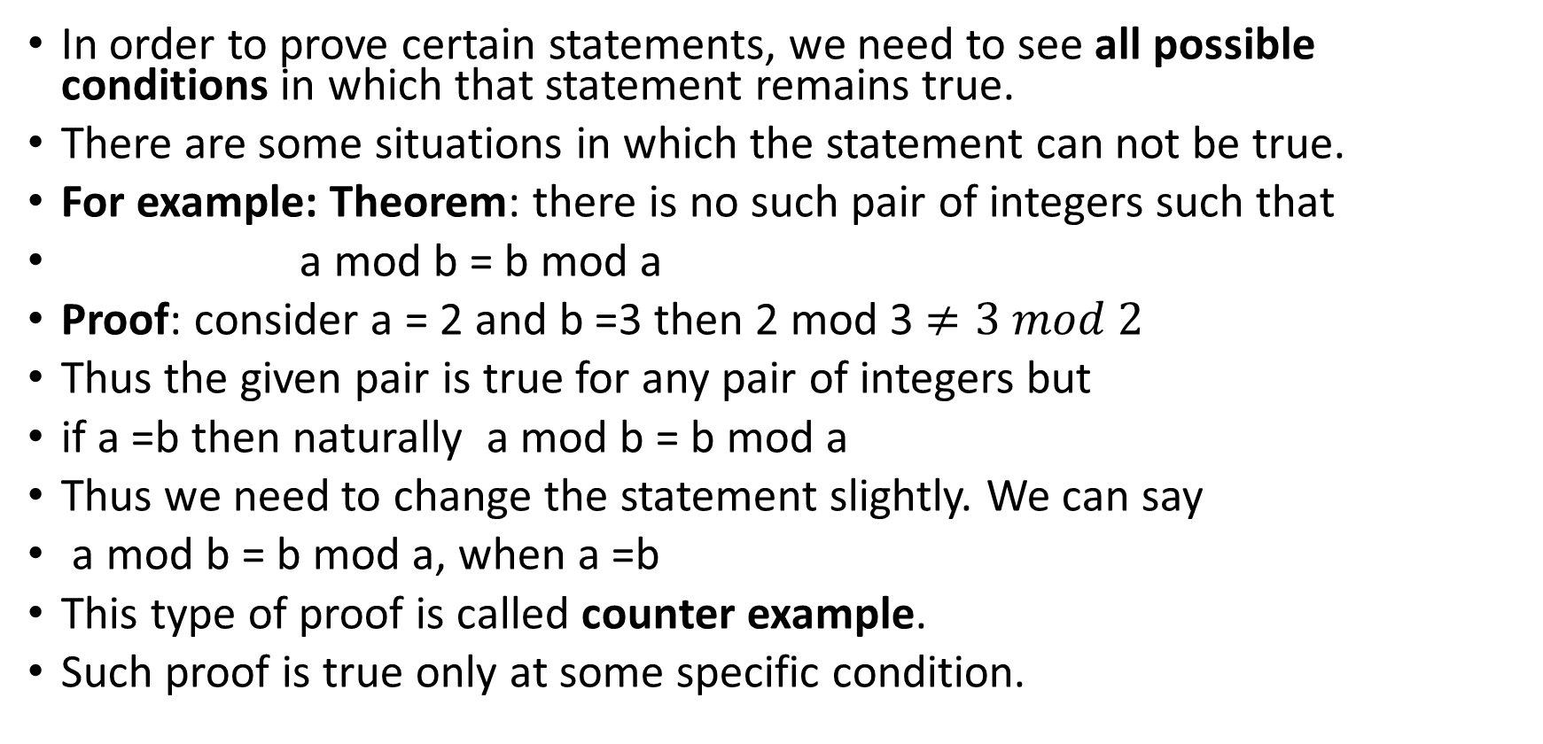
Proof by Counter-example
In order to prove certain statements, we need to see all possible conditions in which that statement remains true.
There are some situations in which the statement can not be true.
For example: Theorem: there is no such pair of integers such that
a mod b = b mod a
Proof: consider a = 2 and b =3 then 2 mod 3 $≠3 mod 2$
Thus the given pair is true for any pair of integers but
if a =b then naturally a mod b = b mod a
Thus we need to change the statement slightly. We can say
a mod b = b mod a, when a =b
This type of proof is called counter example.
Such proof is true only at some specific condition.

Slide 12
Proof by Contraposition
This is a technique of proof in which A B is true if ~ A ~ B.
If negative statement of given statement is true then the given statement becomes automatically true.
Example: prove by contraposition that x + 8 is odd.
Solution: Step 1: we assume that x is not odd
Step 2: that means x is even. By definition of even numbers 2 * any number = even number
x = 2 * m where m can be any number
Step 3: we can write x + 8 as 2 * m + 8 = 2 ( m + 4) = even number
Thus x + 8 is even. That means ( x + 8) is not odd.
From step 1 and 3, we can state that if x is not odd then ( x +8 ) is also not odd.
Hence by contraposition theorem, we can say that x + 8 is odd if x is odd.

